Slide 1
Automated Classification of News Articles by Category
Machine Learning for Business
Professor: Sammie Omranian
By Saketha Gaddam

Slide 2
Introduction and Background
The exponential growth of digital news content has created challenges in organizing and curating articles efficiently.
Manual categorization is time-consuming and prone to errors.
Users often struggle to find relevant content due to overlapping of topics.

Slide 3
Motivation
Why this project?
Automating news categorization improves content moderation and personalized user experiences.
Integrating sentiment analysis adds an extra layer of insight into news content.
Potential Impact:
Enhance digital media platforms by streamlining content management and improving audience engagement.

Slide 4
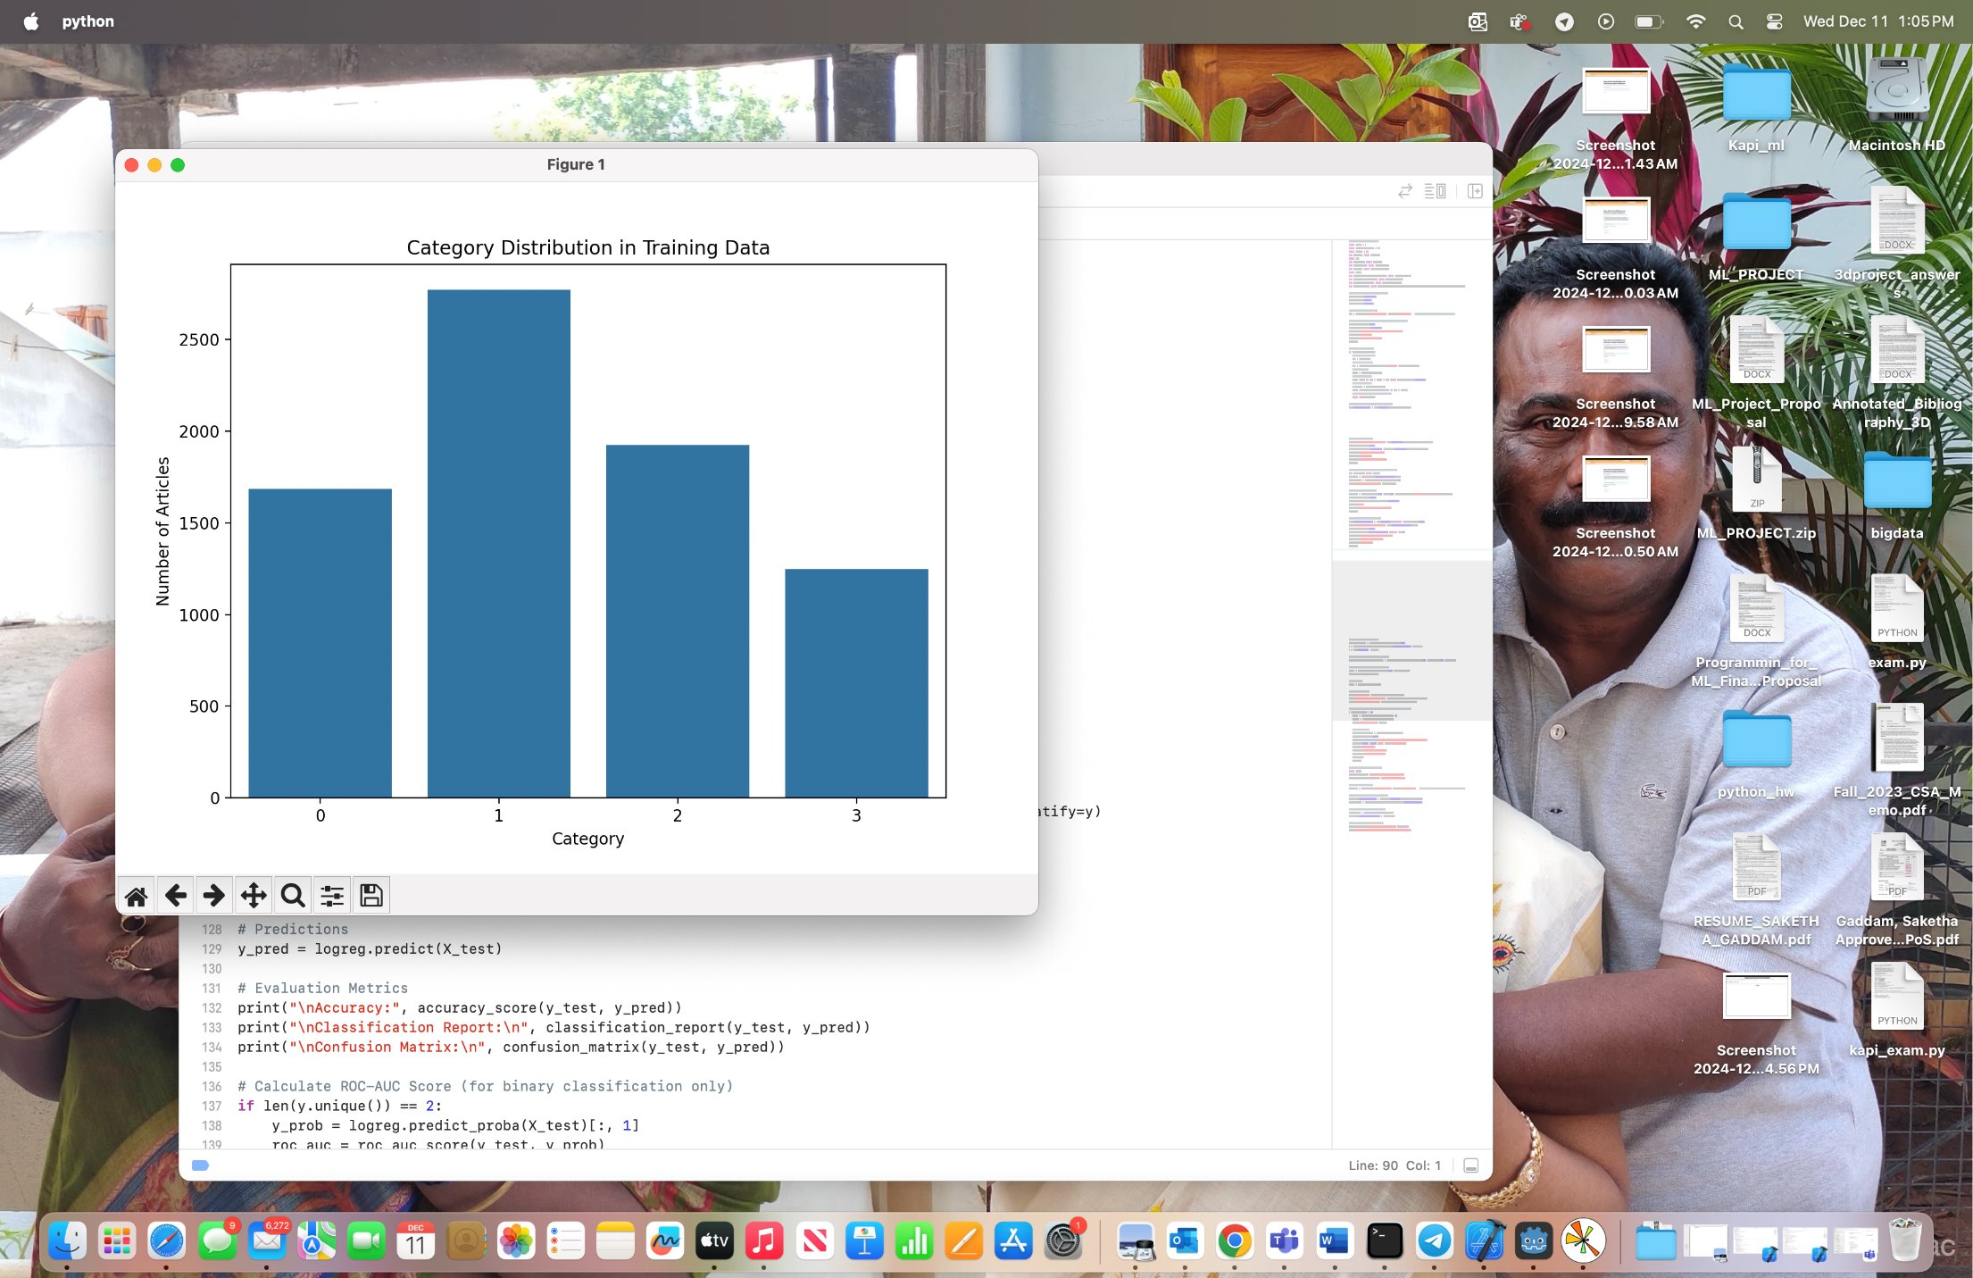
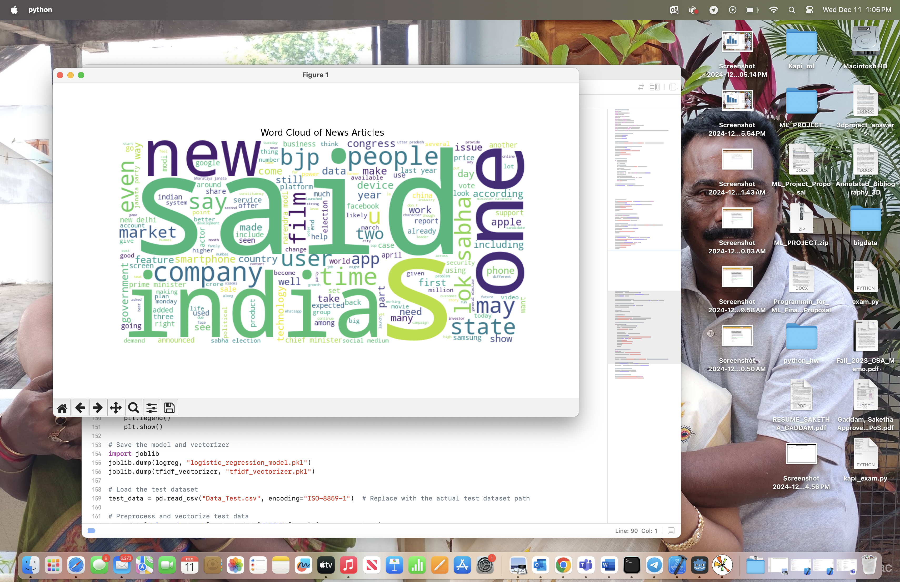
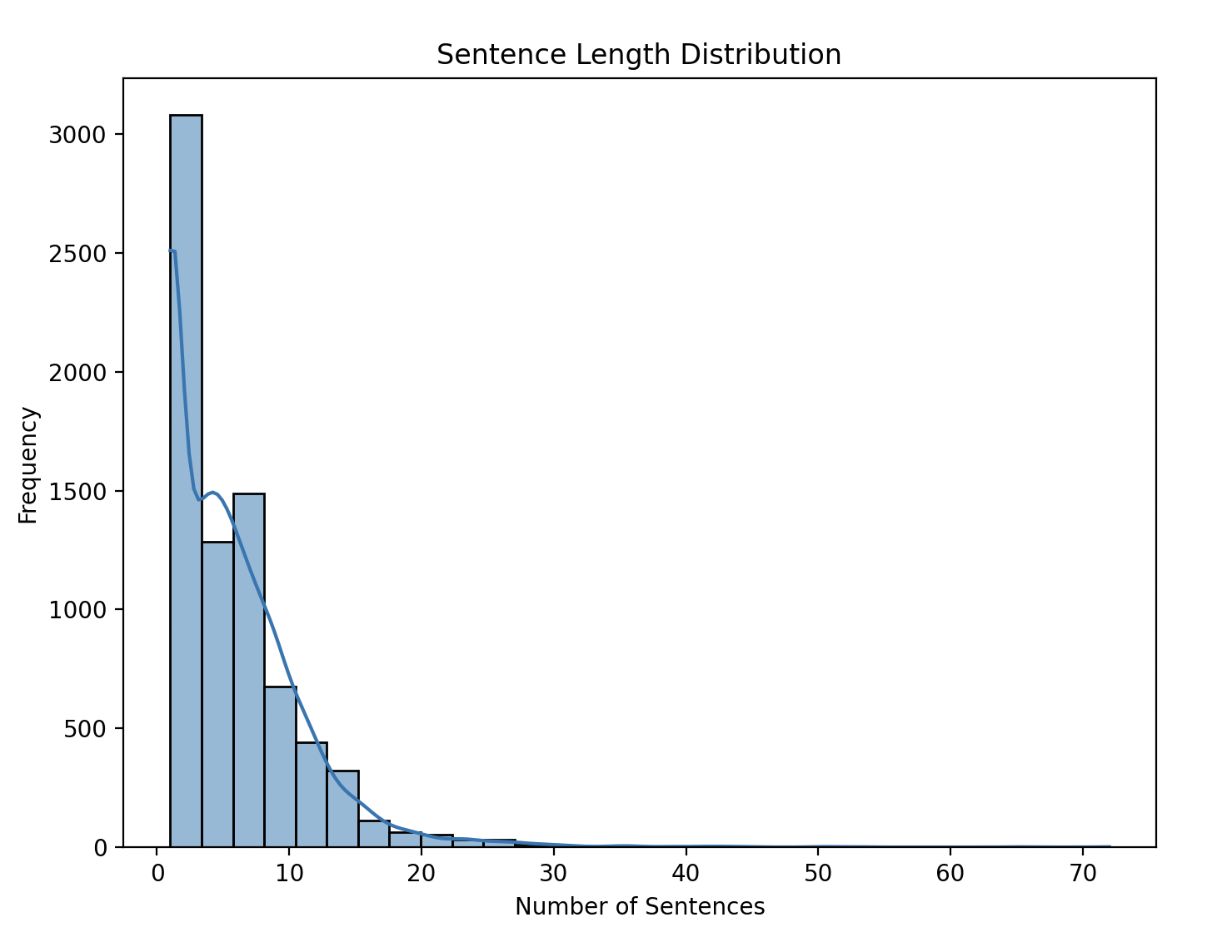
Data Description and Summary Statistics
Dataset:
News Category Dataset by Akash Gupta from Kaggle.
~10,000 news articles distributed across four categories: Politics, Technology, Entertainment, and Business.

Slide 5
Workflow
Data Preprocessing: Tokenization, stopword removal, lemmatization.
Model Training: Fine-tuning BERT for text classification.
Sentiment Analysis: Using NLTK’s Sentiment Intensity Analyzer.
Key Phrase Extraction: Using RAKE algorithm.
Dashboard: A Streamlit app for real-time predictions.

Slide 6
Key Components of the Project
Models: Implemented Logistic Regression, Random Forest, SVM, LSTM, and BERT for text classification.
Sentiment Analysis: Used NLTK’s Sentiment Intensity Analyzer to classify articles as Positive, Neutral, or Negative based on compound scores.
Key Phrase Extraction: Applied RAKE to extract meaningful phrases summarizing the themes of the articles.

Slide 7
Analysis
- BERT delivered the best performance, with the highest accuracy, precision, recall, and F1-scores across all categories, making it the final model for deployment.
- Logistic Regression and SVM showed strong results as lightweight models, performing well with minimal misclassifications.
- Random Forest and LSTM were slightly less effective due to class imbalance handling and higher computational requirements, respectively.

Slide 8
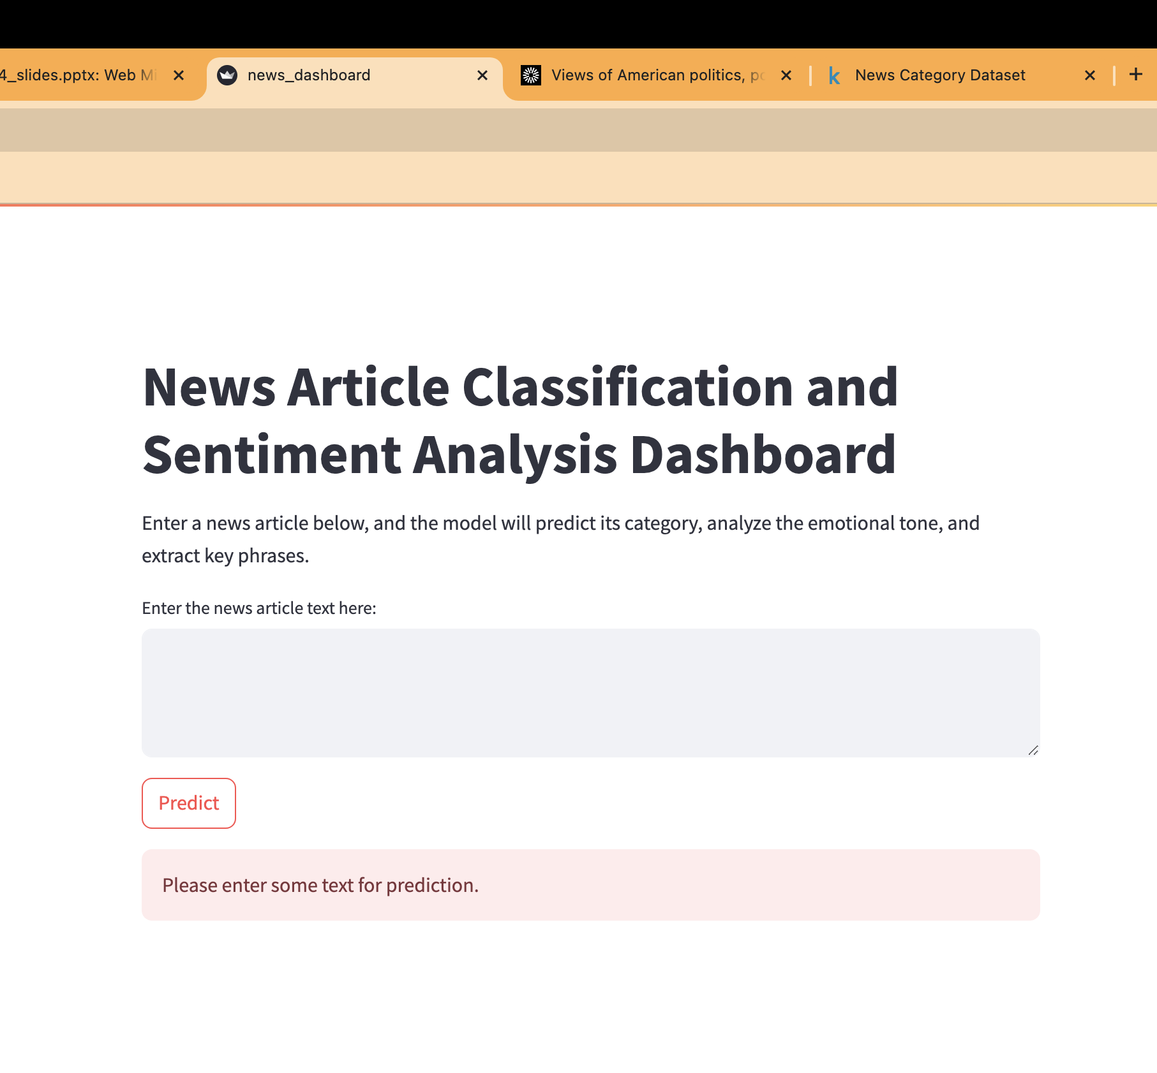
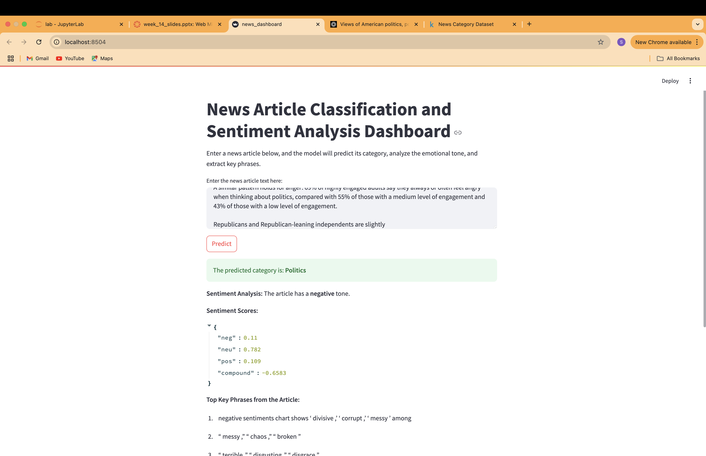
Results

Slide 9
Conclusions and Future Work
Conclusions:
Developed a robust system for automated classification of news articles.
Sentiment analysis enhances interpretability and user engagement.
Future Research:
Expand categories for more granular classification.
Allow users to upload files or process multiple articles in one go.

